Slide 1


Weather Prediction
Using IBM SPSS Modeler
Presented by:
Sidhanta Sahoo Shyam Kumar Soni
Dheeraj Mahapatra Aman Kumar Keshri

Slide 2

Introduction
This project focuses on Weather Prediction using IBM SPSS Modeler.
The predictive analysis is performed on a large-scale weather dataset containing:
3.5+ lakh records and 30+ fields
Comprehensive weather attributes across different countries, cities, and seasons
Historical patterns and trends used to develop five predictive models for accurate forecasting
The dataset serves as a robust foundation for exploring climate behavior, identifying key influencing factors, and improving the accuracy of weather predictions.

Slide 3
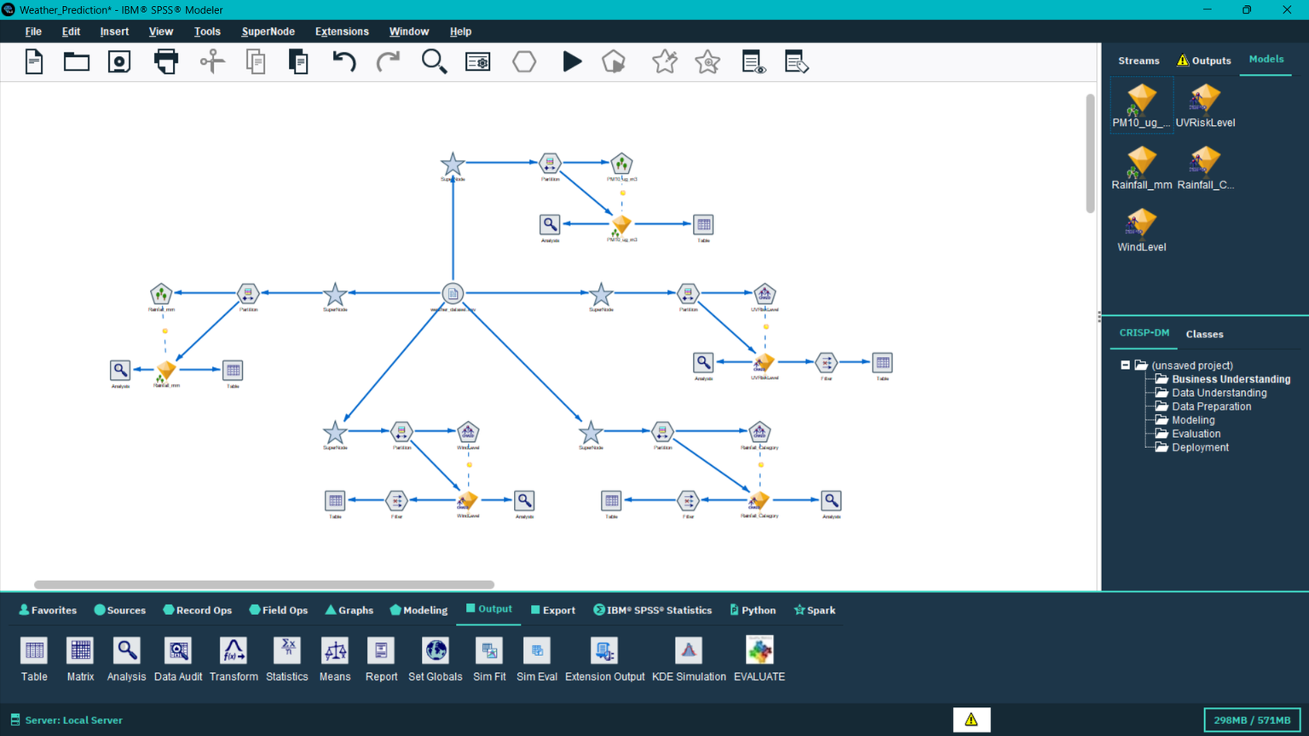
Modeling Workflow in IBM SPSS Modeler
Covers the CRISP-DM process: Data → Modeling → Evaluation
Integrated weather attributes: rainfall category, wind level, UV risk, air quality, rainfall mm.
Data split into training & testing sets
Built multiple models: Random Tress, CHAID Node
Added analysis nodes for performance comparison

Slide 4

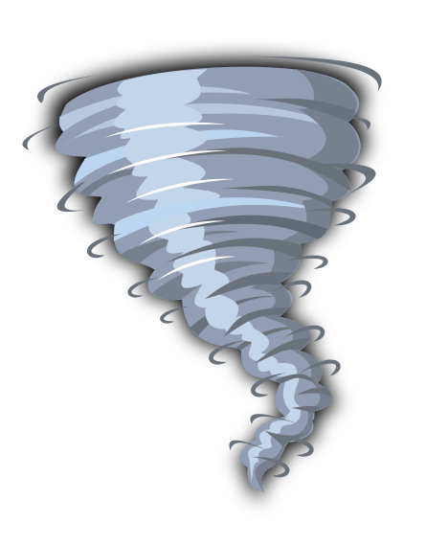




Predictive Models
01
02
03
04
05
Wind Level
Rainfall Amount
Rainfall Category
Air Quality
UV Risk Level
Classification model (CHAID) predicting wind levels using wind speed.
Regression model predicting rainfall (mm) using humidity and related fields.
Classification model predicting rain intensity (light, moderate, high) using fields like rainfall, humidity, etc.
Regression model predicting AQI using pollutant levels (NO₂, SO₂, NO₃, etc.).
Classification model predicting UV radiation risk using sunshine hours and UV index.

Slide 5

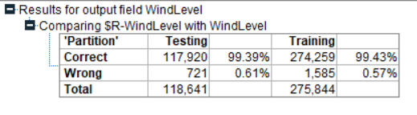


Wind Level Prediction
The Wind Level model predicts whether the wind will be low, medium, or high by analyzing wind speed and gust data. It uses the CHAID classification algorithm, which is particularly effective for categorical predictions. This model not only considers historical wind data but also accounts for trends and sudden changes in wind patterns. Accurate wind predictions are crucial for safety planning, storm alerts, and disaster management.
Applications / Importance:
Issuing storm and high-wind warnings
Disaster preparedness and risk mitigation
Aviation and marine safety

Slide 6
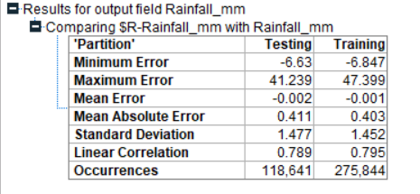

Rainfall Amount Prediction
The Rainfall Amount model estimates the total rainfall in millimeters for a given period. Using regression analysis, it provides continuous numerical predictions. Key inputs include humidity, temperature, and cloud cover, which are highly correlated with precipitation patterns. Accurate rainfall predictions are essential for agriculture planning, water resource management, and flood risk assessment.
Applications / Importance:
Agricultural irrigation and planning
Flood risk and water management
Weather monitoring for city planning

Slide 7
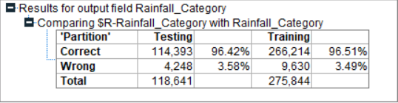

Rainfall Category prediction
This model classifies rainfall intensity into categories: light, moderate, or heavy. It converts numeric rainfall values into understandable categories for easy interpretation. Key inputs include humidity and general weather conditions. Such categorization is important for public weather forecasts, helping individuals and organizations plan outdoor activities effectively.
Applications / Importance:
Simplified public weather forecasts
Travel and outdoor event planning
Quick decision-making for emergency services

Slide 8
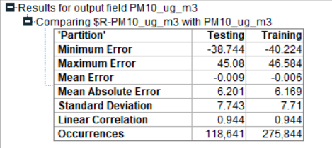

Air Quality Prediction
The Air Quality model predicts the Air Quality Index (AQI) using data from pollutants such as NO₂, SO₂, O₃, PM2.5, and PM10. It uses regression analysis to generate precise numerical AQI values. This model allows authorities to track air pollution trends, evaluate health risks, and implement control measures. Timely AQI predictions are critical for public health advisories, especially for sensitive populations.
Applications / Importance:
Pollution control and monitoring
Public health advisory
Environmental planning and regulations

Slide 9
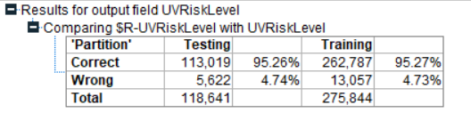

UV Risk Level Prediction
The UV Risk Level model predicts ultraviolet radiation exposure levels—low, moderate, high, or extreme. It uses the UV index and sunshine duration as primary inputs. Classification is applied to clearly define risk categories for public understanding. Accurate UV risk prediction is important for skin protection, outdoor safety, and public health awareness.
Applications / Importance:
Public health and safety advisories
Outdoor activity planning
Skin cancer prevention campaigns

Slide 10

Thank you very much!
Presented by:
Sidhanta Sahoo Shyam Kumar Soni
Dheeraj Mahapatra Aman Kumar Keshri

